Slide 1



SMART HOME
SYSTEM

Slide 2

PRESENTED BY
AHMED OMER
MAHMOUD RABEA
OMER TAHA
HAGER HASSAN
RAWAN MAGDY
MARWA AHMED

Slide 3


PROJECT OVERVIEW
The Atmega32-based smart home project enables user authentication using ID and password. It includes components such as an LCD display and keypad for user interaction. The LM35 temperature sensor monitors the temperature, triggering the activation of an LED, fan, or heater based on temperature conditions. The system activates the fan when the temperature exceeds the abnormal range and the heater when it falls below the abnormal range. The LCD displays the temperature in Celsius and provides feedback on the user attempting to enter their password.

Slide 4
PROJECT COMPONENT
2 Atmega32
1 Keypad
1 LCD
3 LED
1 Buzzer
4 Resistance
1 LM35

Slide 5
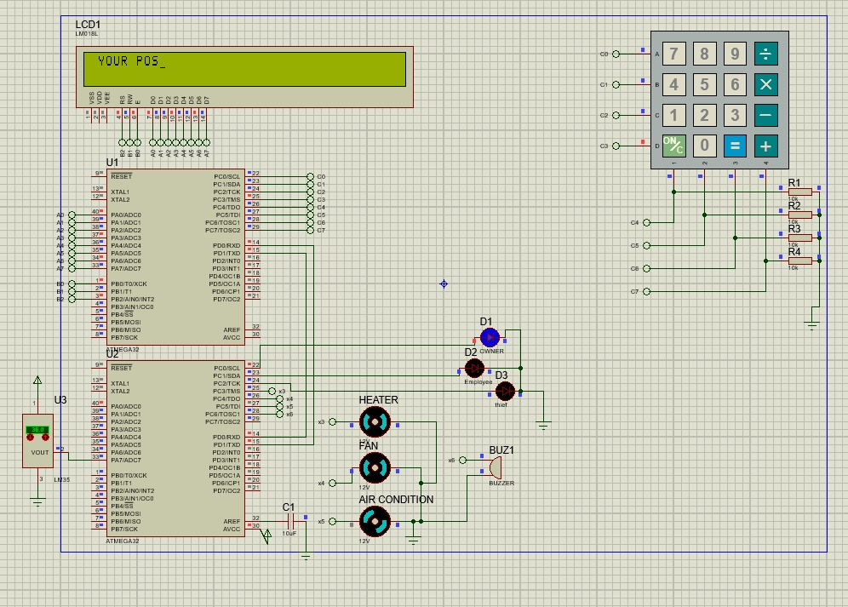
PROJECT IN PROTEUS

Slide 6

DOES ANYONE HAVE QUESTIONS?

Slide 7
THANK YOU
FOR LISTENING

